Slide 1
Gradient Descent Parallelization
0516314 許程翔
0516306 尤健羽
0516319 傅信瑀

Slide 2
Outline
Motivation
Introduction
Proposed solution - Global Update Gradient Descent
Evaluation
Multiple Feature Gradient Descent
Related Work (Local Update Gradient Descent)
Conclusion

Slide 3
Motivation
Datasets for Machine Learning are large
It look a long time to train
Machine Learning can be applied in many ways

Slide 4


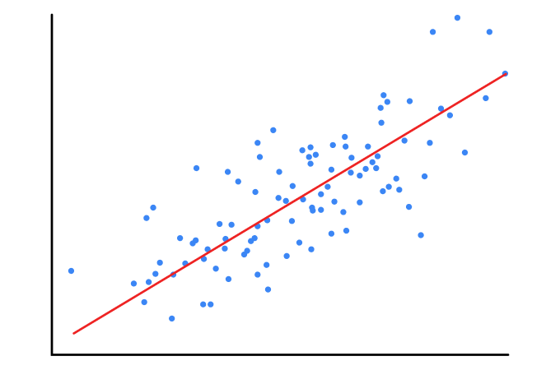
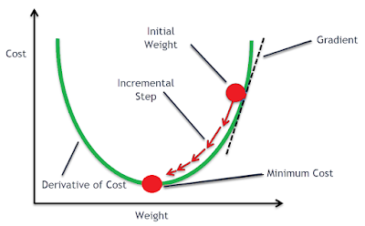

Introduction
cost function:

Slide 5
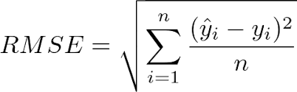
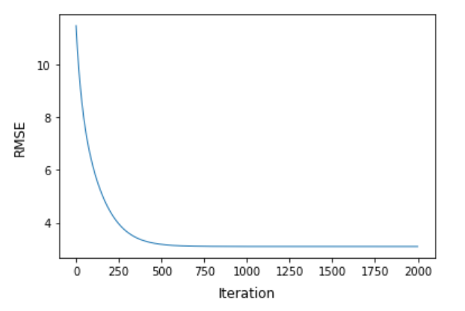
Environment & Input Sets
Data Size: 864860 Iteration: 2000 PP server: Intel Core i7-870 2.93GHz Language: C++ / C

Slide 6
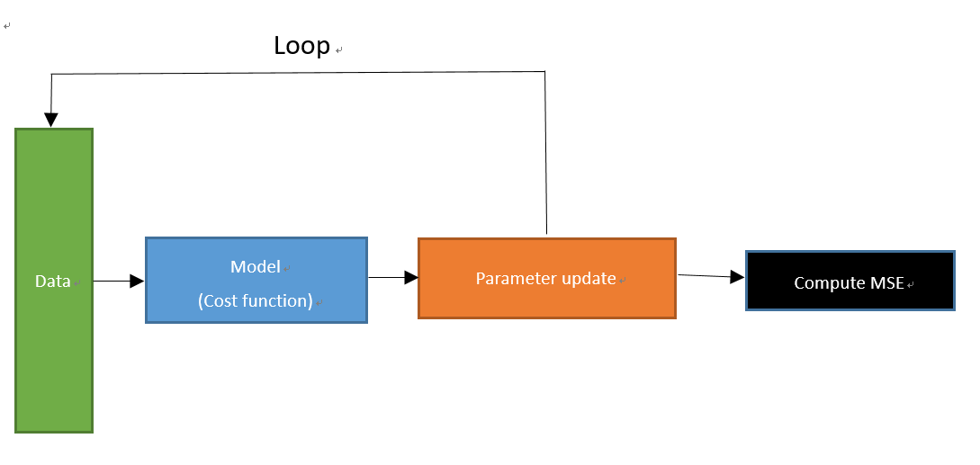
Block Diagram
98.5%

Slide 7
Proposed solution
Global update
Local update

Slide 8
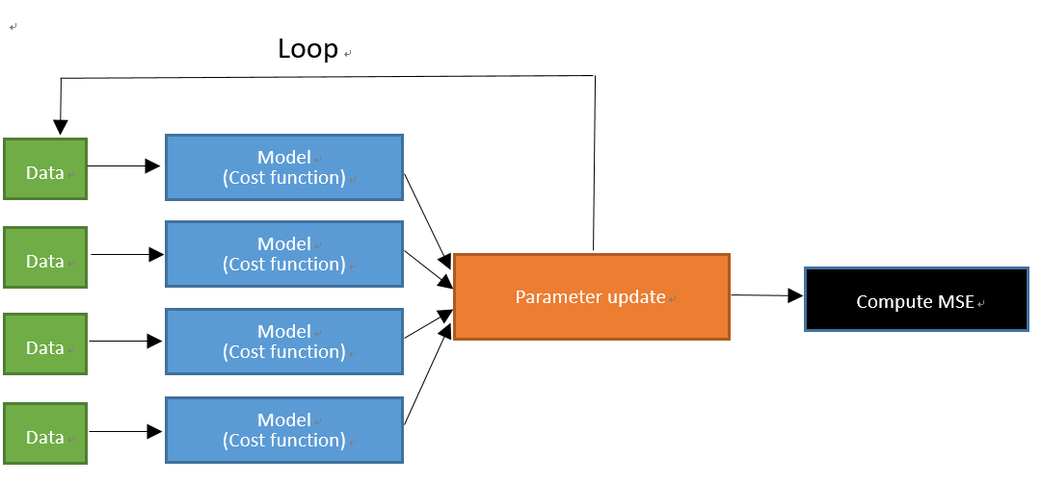
Global update

Slide 9
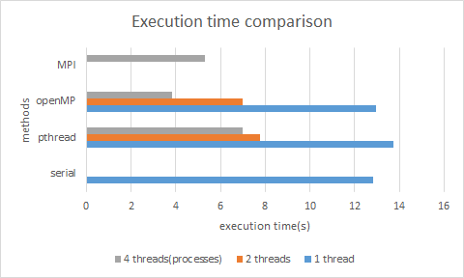
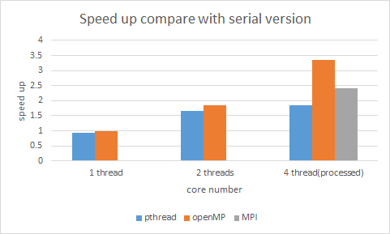
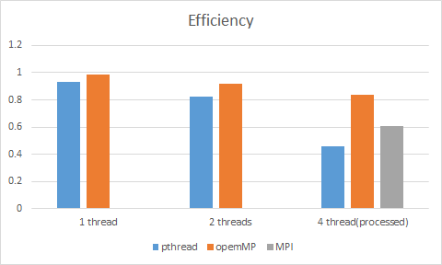
Evalution
parallel
serial
parallel
overhead
parallel

Slide 10
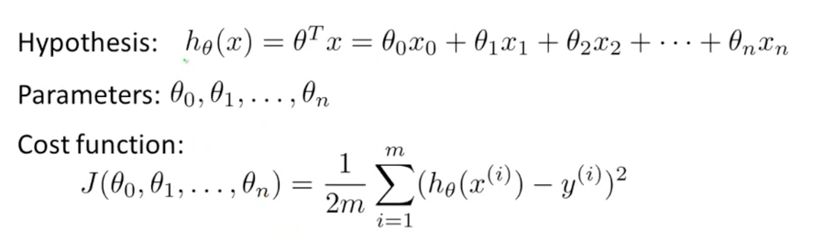
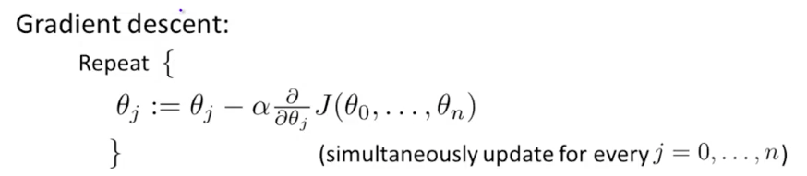
Multiple Linear Regression

Slide 11
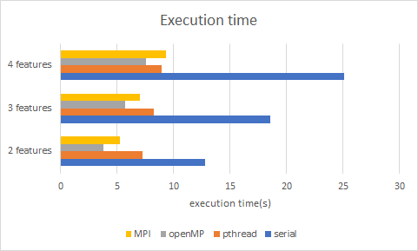
Comparsion

Slide 12
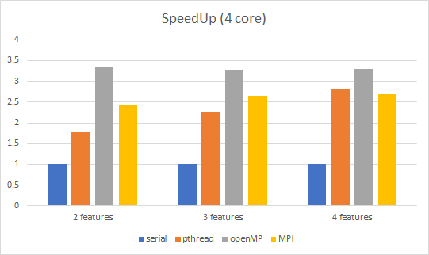
Comparsion

Slide 13
Proposed solution
Global update
Local update

Slide 14
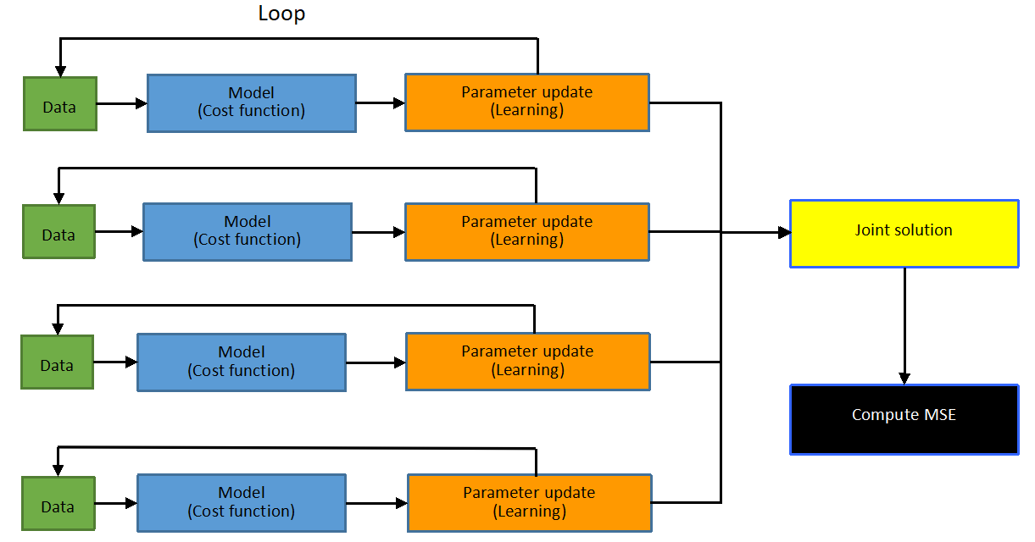
Local update

Slide 15
Local v.s. Global
Pros:
Thread creation only when initiation
Much lower data transmission
No synchronization
Cons:
The result is suboptimal
Cannot handle bad cases, i.e. outlier

Slide 16
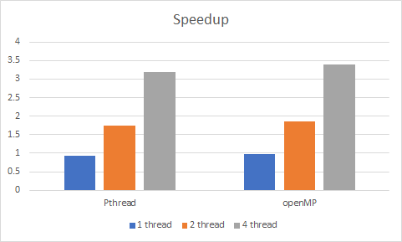
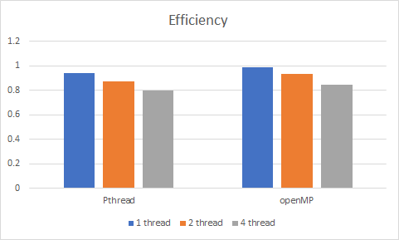
Local update parallelization

Slide 17
The answer is suboptimal. What to do?
Since most of cases has these characteristics:
enough data size
random distribution
This method is good enough to estimate linear regression.

Slide 18
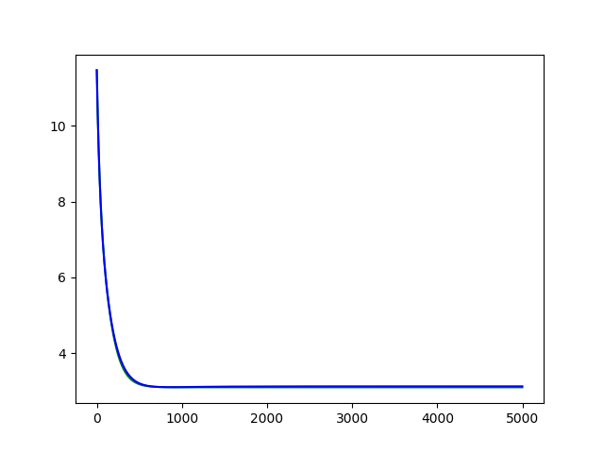
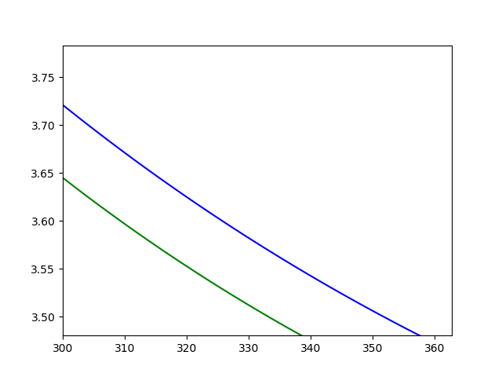
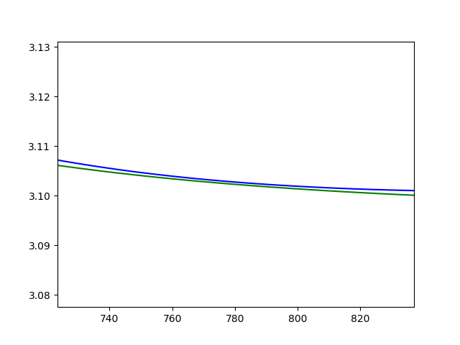
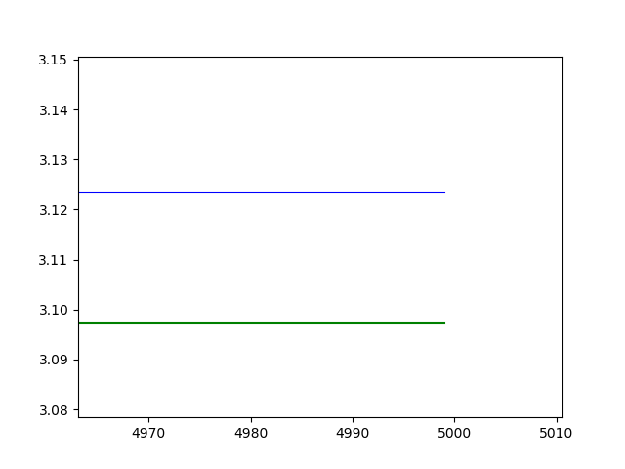
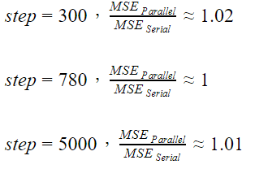
MSE Comparison
Parallelize
Serial

Slide 19
Related research
Martin A. Zinkevich, Markus Weimer, Alex Smola, and Lihong Li. Parallelized Stochastic Gradient Descent. http://martin.zinkevich.org/publications/nips2010.pdf

Slide 20
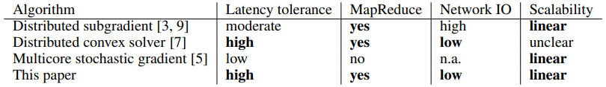
They propose a new approach:
Allow each local machine to randomly draw data points. Run SGD on each machine. Finally, average the parameters across machines to obtain a global solution.
Like our local update GD, this method requires little network communication. But, the parameter estimates are better because each machine is allowed to access a larger fraction of the data.

Slide 21
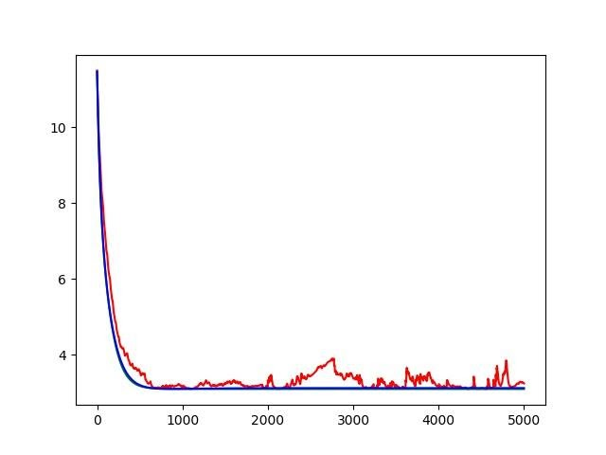
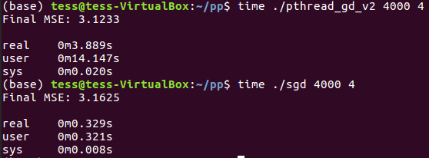
SGD v.s. parallelized GD
SGD
mini-batch = 100

Slide 22
Conclusion
Gradient discent can be parallelized
The speed up of pthread is not as well as openMP. We think there is room for improvement
Pthread : When the data size or features become larger, the speed up will get better due to the calculation of each thread(process) becoming more complex, which results in the percentage of overhead getting lower

Slide 23
Contributions of each member
傅信瑀 | Serial Programming: C++ version Parallel Programming: Pthread, openMP Global update gradient descent
尤健羽 | Serial Programming: C version Parallel Programming: MPI Multiple Linear Regression
許程翔 | Parallel Programming: local update version Related Research

Slide 24
Q&A

